Slide 1


Voice-Based Concept Understanding Analyzer (VBCUA)
SAVEETHA INSTITUTE OF MEDICAL AND TECHNICAL SCIENCES
Presented By:
Bhavani Shanker BHALE
192411238
GUIDED BY:-
Dr . PONMANIRAJ

Slide 2

Abstract
The project evaluates a student's conceptual understanding through voice.
OpenAI Whisper converts the student's speech into text.
Sentence-BERT compares the student's answer with the reference answer.
Librosa analyzes speech quality and fluency.
The system generates scores, feedback, PDF reports, and stores the results.

Slide 3
Introduction
Traditional oral examinations require manual evaluation.
Manual assessment is time-consuming and may be inconsistent.
Existing systems mainly perform speech-to-text conversion.
They do not evaluate the student's conceptual understanding.
Our project uses AI to provide automatic and intelligent assessment.

Slide 4
Objectives
Voice-Based Concept Understanding Analyser (VBCUA) is an AI-based system that evaluates a student's conceptual understanding through voice.
The student records or uploads a spoken answer, which is converted into text using OpenAI Whisper.
The answer is then compared with the reference answer using Sentence-BERT, while Librosa analyzes speech quality and fluency.
Finally, the system generates a score, feedback, and a PDF report, and stores the analysis history in an SQLite database.
This system provides a faster, more accurate, and consistent method of student assessment compared to traditional manual evaluation.

Slide 5
PROBLEM STATEMENT
Manual oral evaluation requires significant time and effort.
Marks may vary due to different evaluator opinions.
Existing systems focus mainly on speech recognition.
Automatic feedback and report generation are often unavailable.
An intelligent voice-based assessment system is required.

Slide 6
PRAPOSED SYSTEM
Develop an AI-based voice assessment application.
Convert speech into text using OpenAI Whisper.
Compare answers using Sentence-BERT semantic analysis.
Evaluate speech quality using the Librosa library.
Generate reports and store results in an SQLite database.

Slide 7
Literature Survey
Year | Author(s) | Paper Title | Technology | Limitation
2021 | Alec Radford et al. | Learning Transferable Visual Models From Natural Language Supervision (CLIP) | Deep Learning, Transformer | Not designed for speech assessment.
2022 | Alec Radford et al. | Robust Speech Recognition via Large-Scale Weak Supervision | Whisper, ASR, Transformer | Only converts speech to text.
2023 | Johnson A. et al. | Oral Language Assessment Using Large Language Models | Whisper, BERT, NLP | No report generation or database.
2024 | Wang et al. | Automatic Speech Recognition in Language Learning | ASR, NLP | Focuses on pronunciation only.
2025 | Owen Henkel et al. | Supporting Literacy Assessment Using Speech Models | Whisper V2, AI | Evaluates reading, not concept understanding.

Slide 8
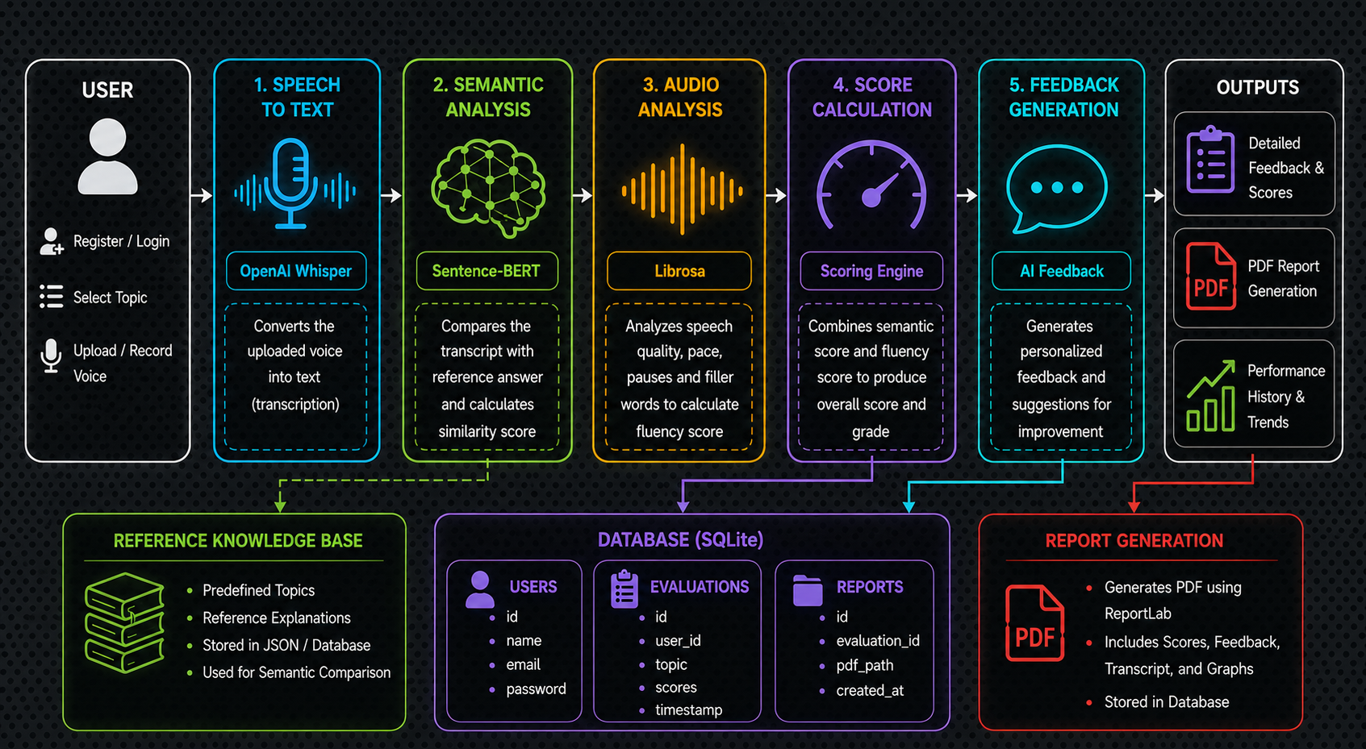
Architecture

Slide 9
Modules Used
User Authentication Module – Register and Login users securely.
Speech Recognition Module – Converts voice into text using Whisper.
Semantic Analysis Module – Uses Sentence-BERT to compare meanings.
Audio Analysis Module – Evaluates fluency using Libros.
Report & Database Module – Generates reports and stores history in SQLite.

Slide 10
1. User Authentication Module
Provides secure user registration and login functionality.
Validates user credentials before allowing access to the application.
Maintains individual user accounts and profiles.
Prevents unauthorized users from accessing analysis results.
Provides a personalized workspace for storing and viewing user history.

Slide 11
2. Speech Recognition Module
Accepts audio input through microphone or uploaded audio files.
Uses OpenAI Whisper to convert speech into text.
Handles different speaking styles and accents.
Produces the transcribed text for further analysis.
Passes the transcription to the semantic and audio analysis modules.

Slide 12
3. Semantic Analysis Module
Uses Sentence-BERT (SBERT) to understand the meaning of the student's response.
Compares the student's explanation with the expected concept.
Calculates semantic similarity between the responses.
Identifies whether the student has understood the main concept.
Generates an understanding score based on semantic similarity.

Slide 13
4. Audio Analysis Module
Uses Librosa to extract important features from the audio.
Analyzes characteristics such as pitch, energy, and speaking rate.
Helps evaluate the student's speech fluency.
Detects variations in speaking patterns and pauses.
Combines audio characteristics with other analysis results to evaluate overall performance.

Slide 14
5. Report & Database Module
Generates a detailed analysis report containing scores and feedback.
Uses SQLite to store user information and analysis history.
Saves previous transcription and evaluation results.
Allows users to review their previous performance.
Provides downloadable reports for tracking learning progress.

Slide 15
CONCLUSION
Successfully developed an AI-based Voice-Based Concept Understanding Analyser.
Implemented secure user registration and login using SQLite. Converted student voice into text using OpenAI Whisper. Evaluated conceptual understanding using Sentence-BERT and analyzed speech using Librosa.
Generated scores, feedback, PDF reports, and stored analysis history successfully.

Slide 16
FUTURE SCOPE
Allow teachers to add custom topics and reference answers dynamically.
Improve semantic evaluation using advanced Large Language Models (LLMs).
Deploy the application on cloud platforms for online access. Support multiple languages for voice-based assessment.
Integrate a dashboard for teachers to monitor student performance and progress.

Slide 17
THANK YOU!

